Slide 1

AI Learning Advisor Agent
Copilot Scenario Overview Deck
© 2026 Microsoft Corporation All rights reserved.
Notes:
CELA disclaimer
Terms displayed or discussed are for explanation/education only. Such terms may differ from your agreement.

Slide 2
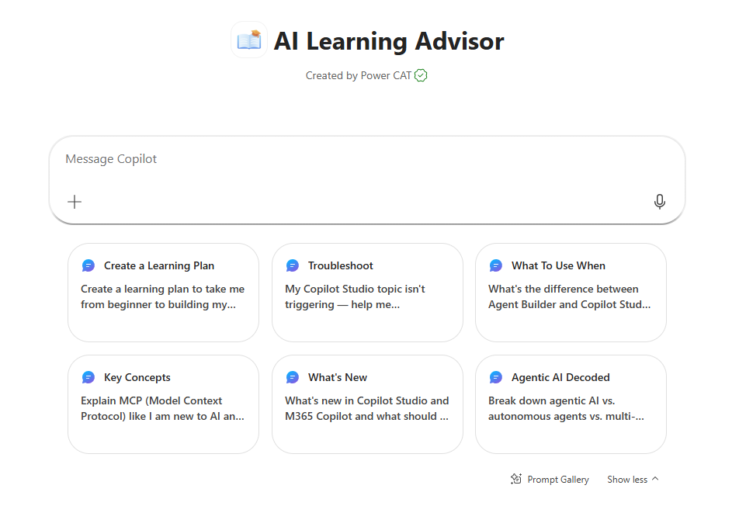
AI Learning Advisor Agent Summary
Agent Overview
Key Challenges
Trusted answers on the stack are slow to find
Documentation is fragmented across many product domains
Repetitive technical questions tie up subject matter experts
Inconsistent answers create rework and compliance risk
Provide fast, trusted, step-by-step guidance on the Microsoft technology stack — from Azure and Power Platform to Microsoft 365 and Entra ID — grounded in official Microsoft Learn documentation.
Business Outcomes
Faster time to resolution with instant, trusted technical guidance
Unified knowledge access across the entire product portfolio
Subject matter experts freed up to focus on high-value work
Consistent, compliant answers that reduce rework and mitigate risk
Technical Features
💬 Conversational access via Microsoft 365 Copilot
📖 Declarative agent grounded in the Microsoft Learn website & Copilot Developer Camp website
🔗 Step-by-step answers with citations to source docs
⚙️ Multi-product coverage: Azure, Power Platform, M365, Entra ID, and beyond
© 2026 Microsoft Corporation All rights reserved.
Notes:
CELA disclaimer
Terms displayed or discussed are for explanation/education only. Such terms may differ from your agreement.

Slide 3
Table of Contents
Overview
Persona Example
User Journey Scenario Example
Solution Screenshots
Demo Prompts
Notes:
CELA disclaimer
Terms displayed or discussed are for explanation/education only. Such terms may differ from your agreement.

Slide 4
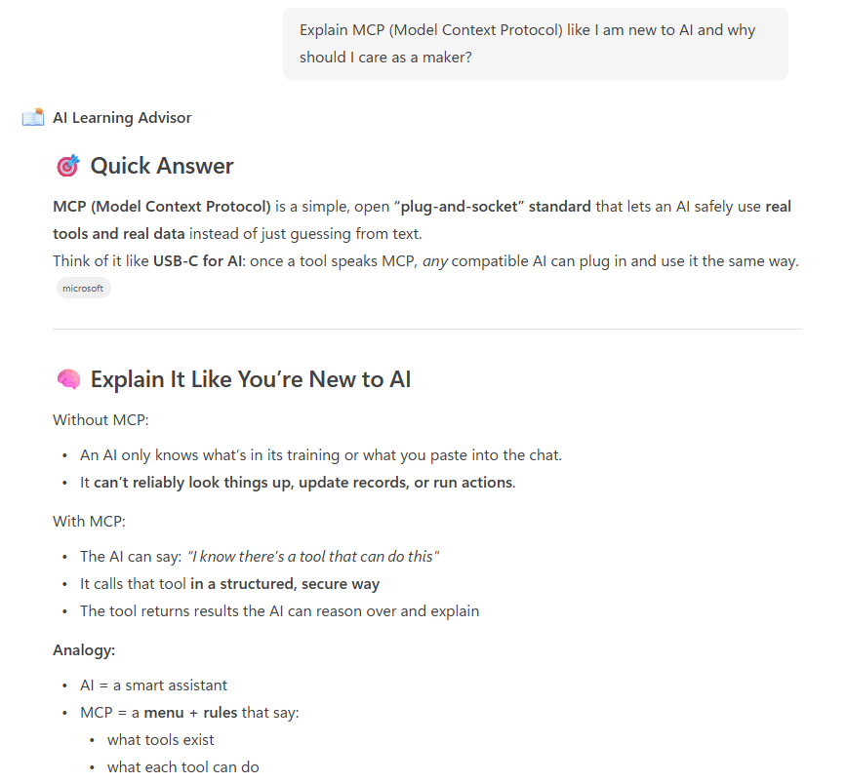
AI Learning Advisor is a declarative agent grounded in the Microsoft Learn website. It acts as a go-to support buddy for the Copilot stack — delivering concise, accurate answers, step-by-step guidance, and troubleshooting tips directly in the flow of work.
By citing Microsoft Learn pages, it provides consistent, compliant guidance at scale and reduces dependency on SMEs for repetitive technical questions.
Overview
© 2026 Microsoft Corporation All rights reserved.

Slide 5


Persona Example
Two core personas: the developer or maker building on the Microsoft stack and the knowledge worker learning a new product or feature.
Developer / Maker
Knowledge Worker
Builder
Learner
Builds on the Microsoft stack across Azure, Power Platform, M365
Wants step-by-step, citation-backed guidance in the flow of work
Adopting a new Microsoft product or feature
Needs trusted answers without browsing many docs
Typical Ask
“How do I create my first Power Automate flow step by step?”
Typical Ask
How do I create an autonomous agent? Provide me examples of triggers..
Key Challenges Addressed
Trusted answers on the Copilot stack are hard to find quickly; docs are fragmented; repetitive questions overload SMEs and create inconsistent guidance.

Slide 6


User Journey
From a single technical question to a step-by-step, citation-backed answer, the agent eliminates the time spent navigating fragmented documentation.
1
Trigger
2
Evaluation
3
Output
User asks the agent in Copilot, e.g., “Steps to create a Declarative Agent” or “Provide me a Power Platform governance checklist”.
Agent retrieves and reasons over relevant Microsoft Learn documentation and assembles a structured, accurate answer with hands on learning to the Copilot Developer camp for Power Platform related responses.
Step-by-step answer with citations to sources.
Backbone
Microsoft Learn & Copilot Developer Camp websites
Declarative agent grounding
Citation-backed answers

Slide 7





High Level Agent Architecture
AI Learning Advisor Agent
How it works
User interacts with the agent in Microsoft 365 Copilot App or Teams App
Declarative agent retrieves relevant information from the Microsoft Learn and/or Copilot Developer Camp sites
Agent reasons over the information and assembles a structured answer
Step-by-step guidance returned with citations to source webpages
Microsoft Teams
1
2
Microsoft Learn website
Copilot Developer Camp website
End User
AI Learning Advisor Agent
Developer
Maker
Knowledge Worker
Declarative Agent
Microsoft 365 Copilot
Knowledge Sources

Slide 8
Agent Solution Screenshots
© 2026 Microsoft Corporation All rights reserved.
Notes:
Title: Click-through demo
Now, let’s see how that all comes together for our key persona.
CELA disclaimer
Terms displayed or discussed are for explanation/education only. Such terms may differ from your agreement.

Slide 9
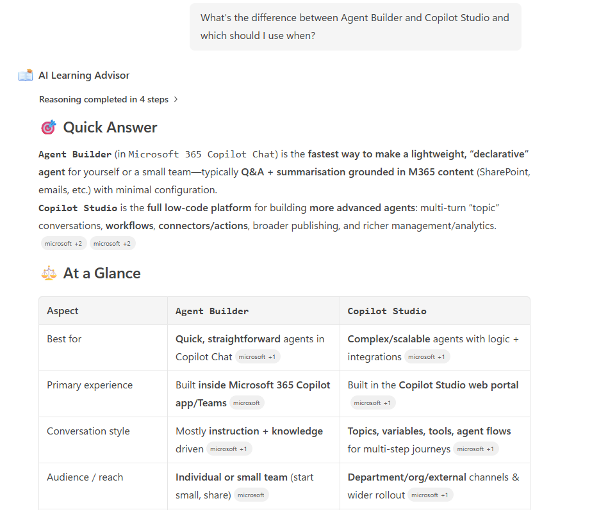
Agent Snapshot

Slide 10
Demo Prompts & Eval Set
Notes:
CELA disclaimer
Terms displayed or discussed are for explanation/education only. Such terms may differ from your agreement.

Slide 11
Demo Prompts & Eval Set
ID | Test Scenario | Prompt | Expected Result
1 | Build a Learning Plan | “Create a learning plan to take me from beginner to building my first Copilot Studio agent.” | Returns a 4-phase beginner learning plan with Microsoft Learn links and a clear next step. 📚
2 | Troubleshoot a Problem | “My Copilot Studio topic isn't triggering — help me troubleshoot it?” | Asks for context, then returns up to 3 ranked Cause → Fix → Verify suggestions with a Learn link. 🛠️
3 | What To Use When | “What's the difference between Agent Builder and Copilot Studio and which should I use when?” | Returns an Agent Builder vs. Copilot Studio comparison table with a recommendation and Learn link. ⚖️
4 | Explain a Concept (Beginner) | “Explain MCP (Model Context Protocol) like I am new to AI and why should I care as a maker?” | Returns a beginner-friendly explanation of MCP with an analogy, why-it-matters, and Learn link. 🧠
5 | What’s New | “What's new in Copilot Studio and M365 Copilot and what should I try first?” | Returns grouped What's New items per product with a Try First section and Learn links. 🆕
6 | Compare Features | “Break down agentic AI vs. autonomous agents vs. multi-agent orchestration.” | Returns a comparison table of agentic AI, autonomous agents, and multi-agent orchestration. 🤖
7 | Pro Dev + Hands On Labs | “I am a pro code developer, which labs should I complete in the Copilot Developer Camp and why?” | Recommends a focused set of Pro Dev Copilot Developer Camp labs with reasons and links. 🧪
8 | Understanding Core Concepts | “What is an autonomous agent? How do I create one if I am already a Maker?” | Defines autonomous agents and walks through building one in Copilot Studio with a Learn link. 🛠️
9 | Produce an ALM + Governance Checklist | “IT wants me to do some research on ALM and Governance for Power Platform before building an agent. Can you help me understand what ALM is and provide me with a governance checklist that I can show the IT team?” | Defines ALM and delivers a Power Platform governance checklist with Learn links. ✅
10 | Brainstorm Agent Ideas | “I am in Marketing and am new to building agents. Can you help me brainstorm some ideas for agents?” | Pitches 4–6 marketing agent ideas with tool and knowledge hints plus a Learn link. 💡

Slide 12
Thank You
Notes:
CELA disclaimer
Terms displayed or discussed are for explanation/education only. Such terms may differ from your agreement.

